Slide 1
Year 1 Welcome meeting 2019

Slide 2
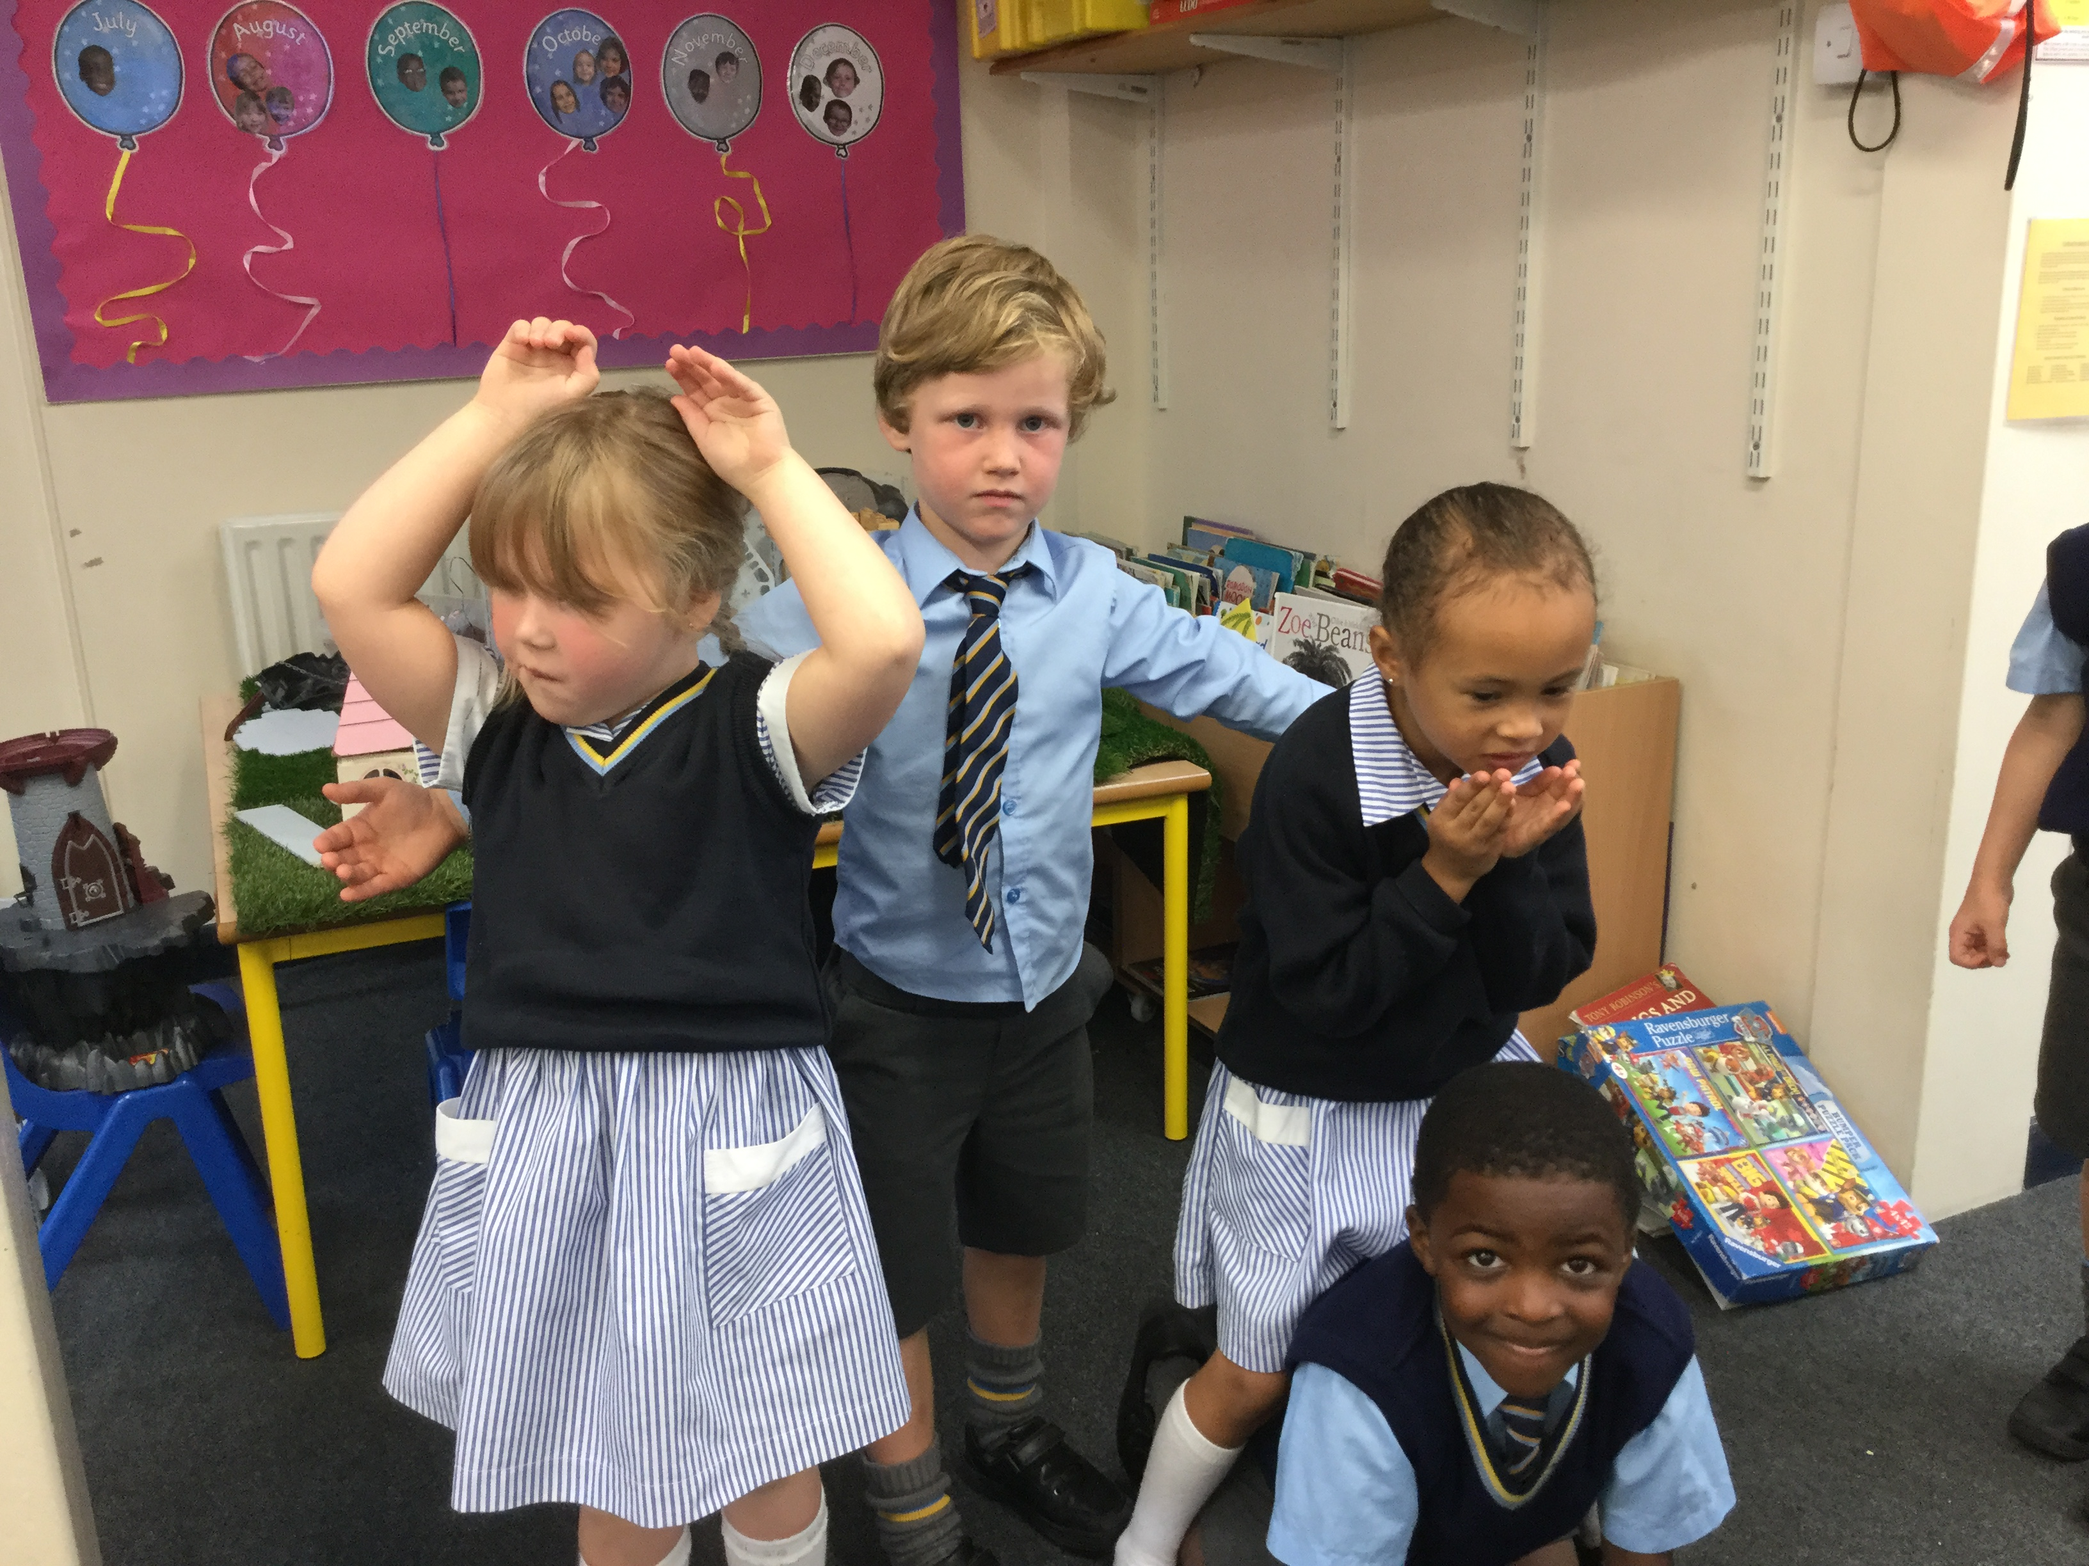
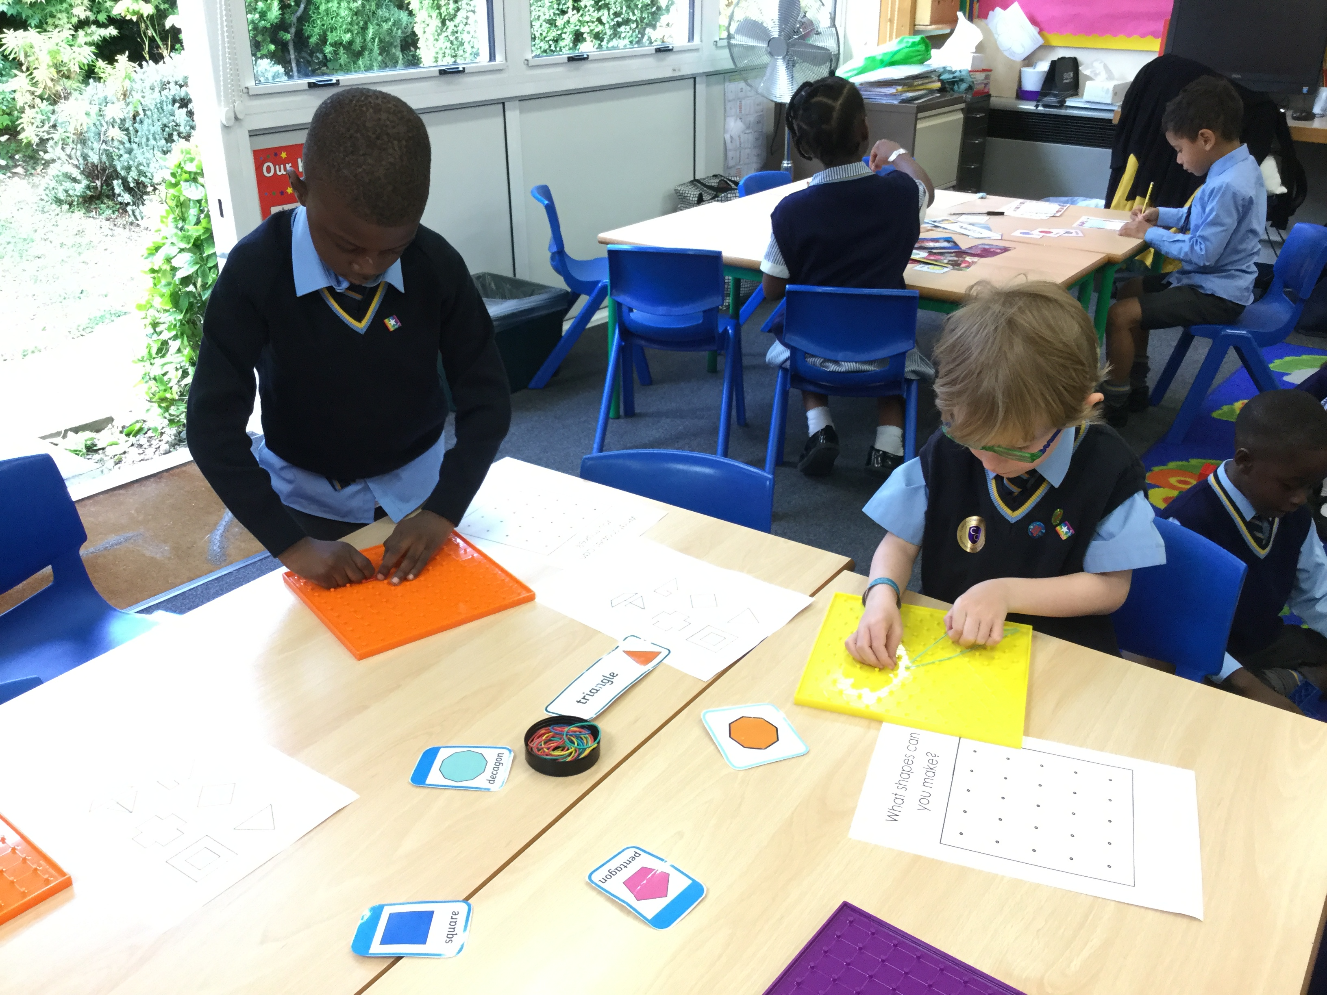
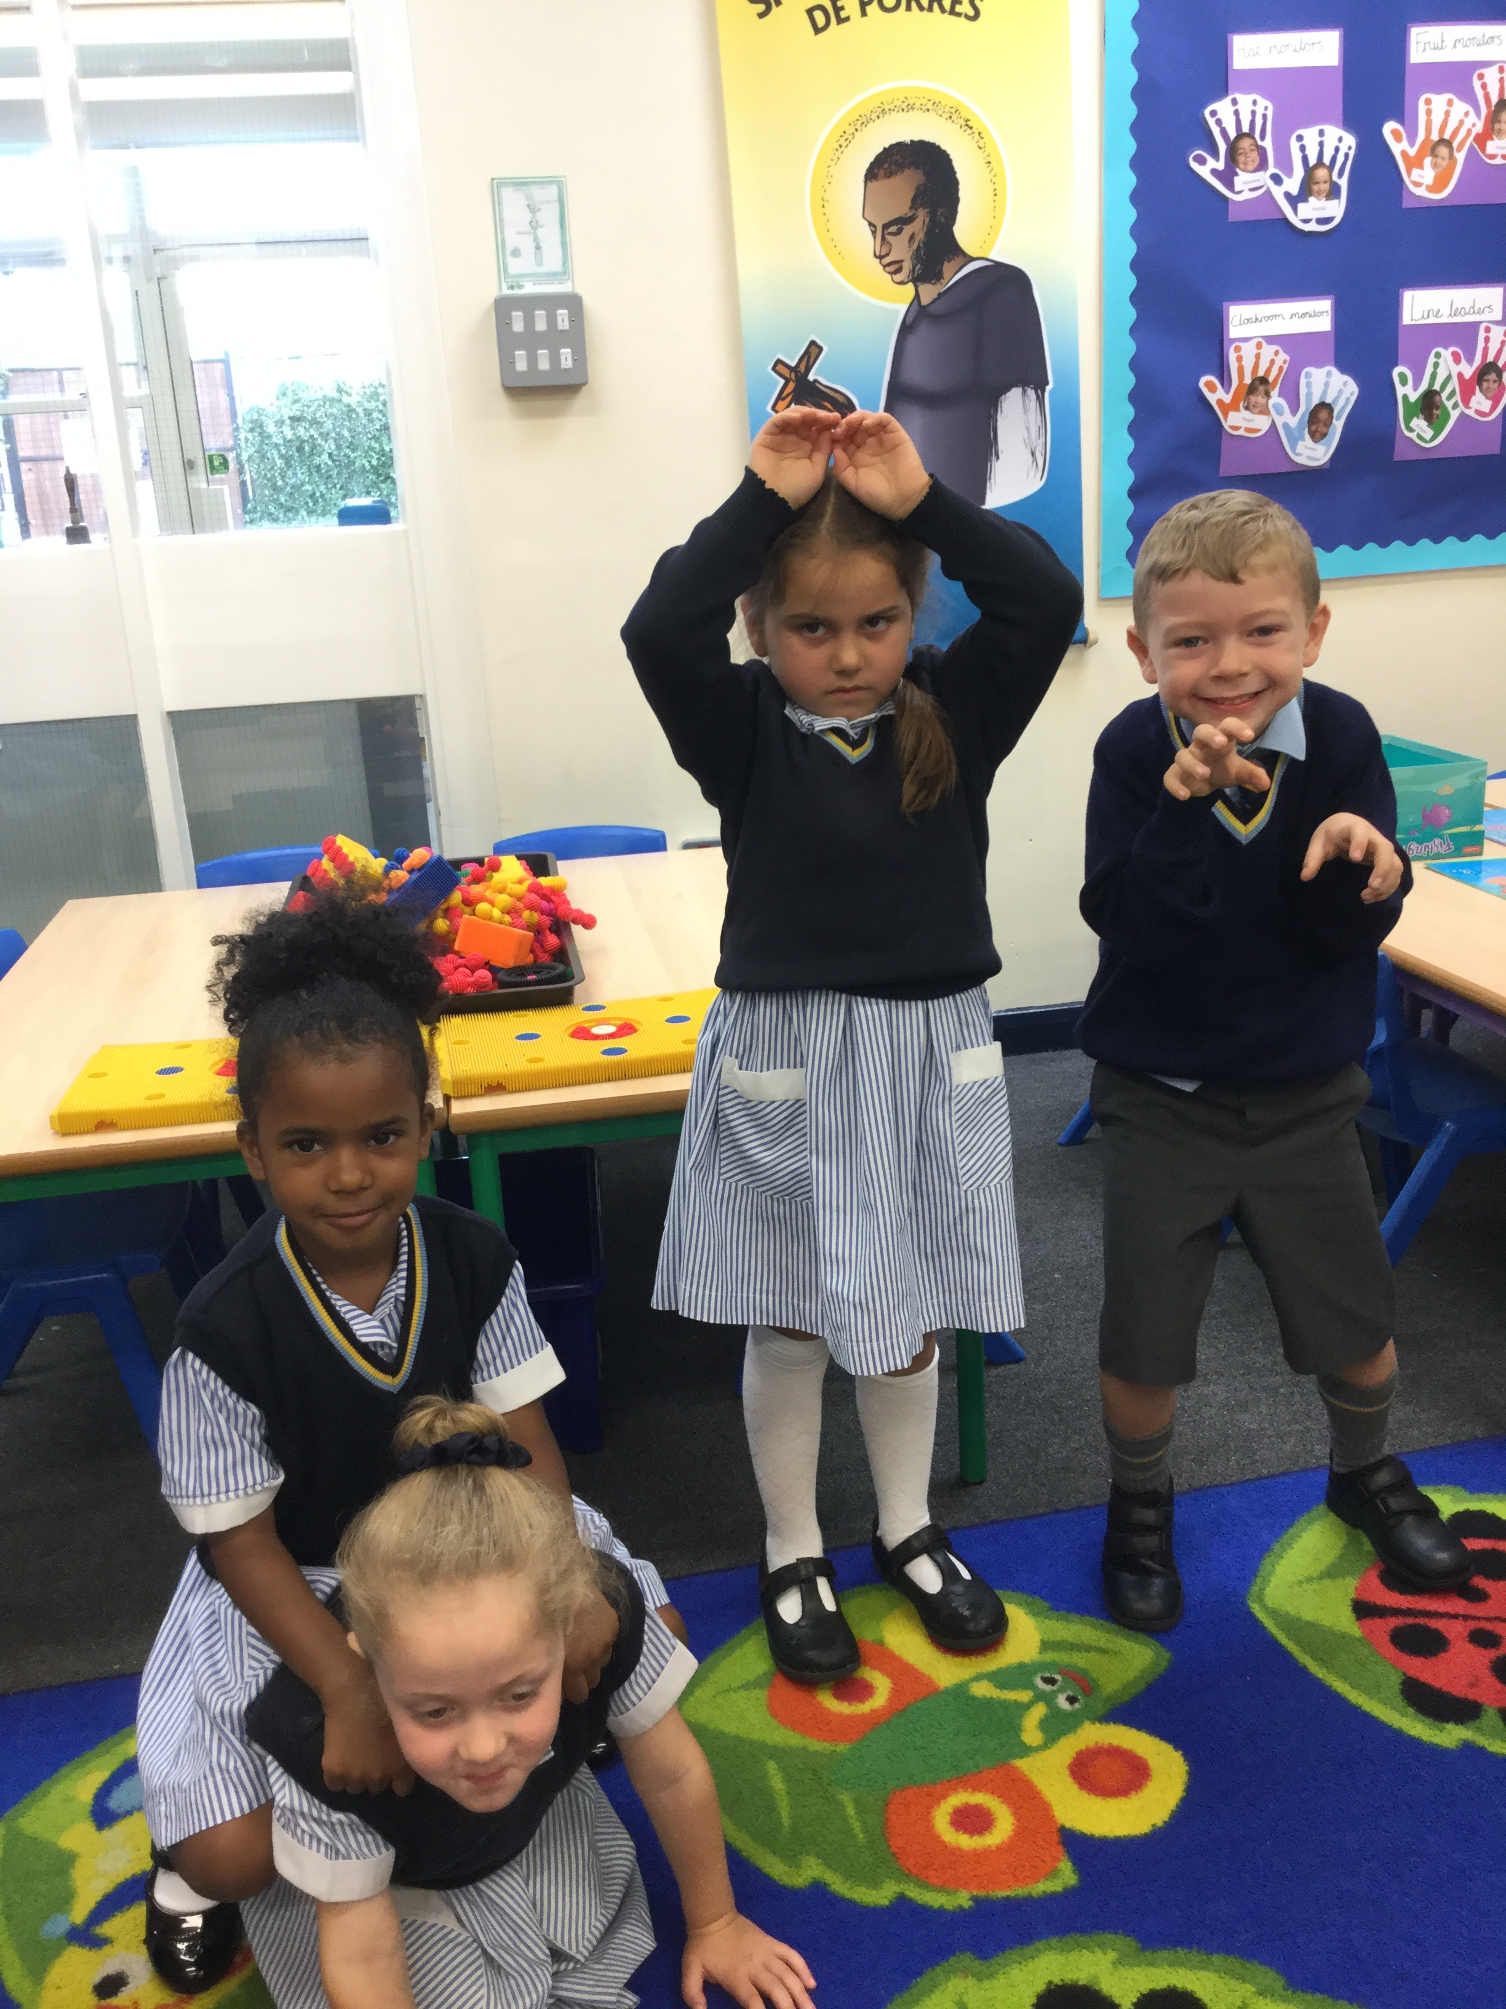
Year 2 staff
Class 3 teacher: Mrs Jenson
Class 4 teacher: Miss Earle
Teaching assistants: Mrs Gutierrez
Mrs Best

Slide 3
CInsert who to see protocol

Slide 5
Contact
cearle@corpuschristi.lambeth.sch.uk
gjenson@corpuschristi.lambeth.sch.uk
Teachers are available from 8:45am if you need to inform them of a change in collection or inform us of news in regards to your child.
Teachers email is to be used for: checking homework, checking dates, volunteering for trips, informing the office and the teacher of appointments and to request a meeting with your teacher.
If there is a matter that needs to be discussed in person we encourage you to email us to request an appointment.
Please note, teachers do not always get the chance to check email throughout the day. We aim to respond to emails within 48 hours.
If your child needs medicine to be administered, please go to the school Reception and fill out a permission slip.

Slide 6
Good behaviour is:
Politeness and courtesy
Sensitivity to the needs of others
Respect for all children and adults
Listening and speaking appropriately
Working co-operatively
Always trying hard and doing our best
Orderly movement around school
Respect for property
Honesty
Mr Calvey
School Pastoral Care leader

Slide 7
Polite reminders
Children must be in line before the bell rings at 8:50am. If they are not they will be marked 'late'.
If you have arranged for another parent or family member to collect your child, please inform the class teacher in the morning or by email.
If a last-minute change is made to end of day collection please ring the school office and they will inform the class teacher.
If we do not know about changes to collection, we will have to take your pupil to the office so we can ring you to check before we can send your child home.
Teachers cannot give permission for absences. Please speak to Mrs Tatton at Reception.
We ask that you do not send in sweets for birthday treats. In the past parents have sent in stickers or similar.
If you do not want your child to be included in any school photos/videos please inform the teacher.

Slide 8
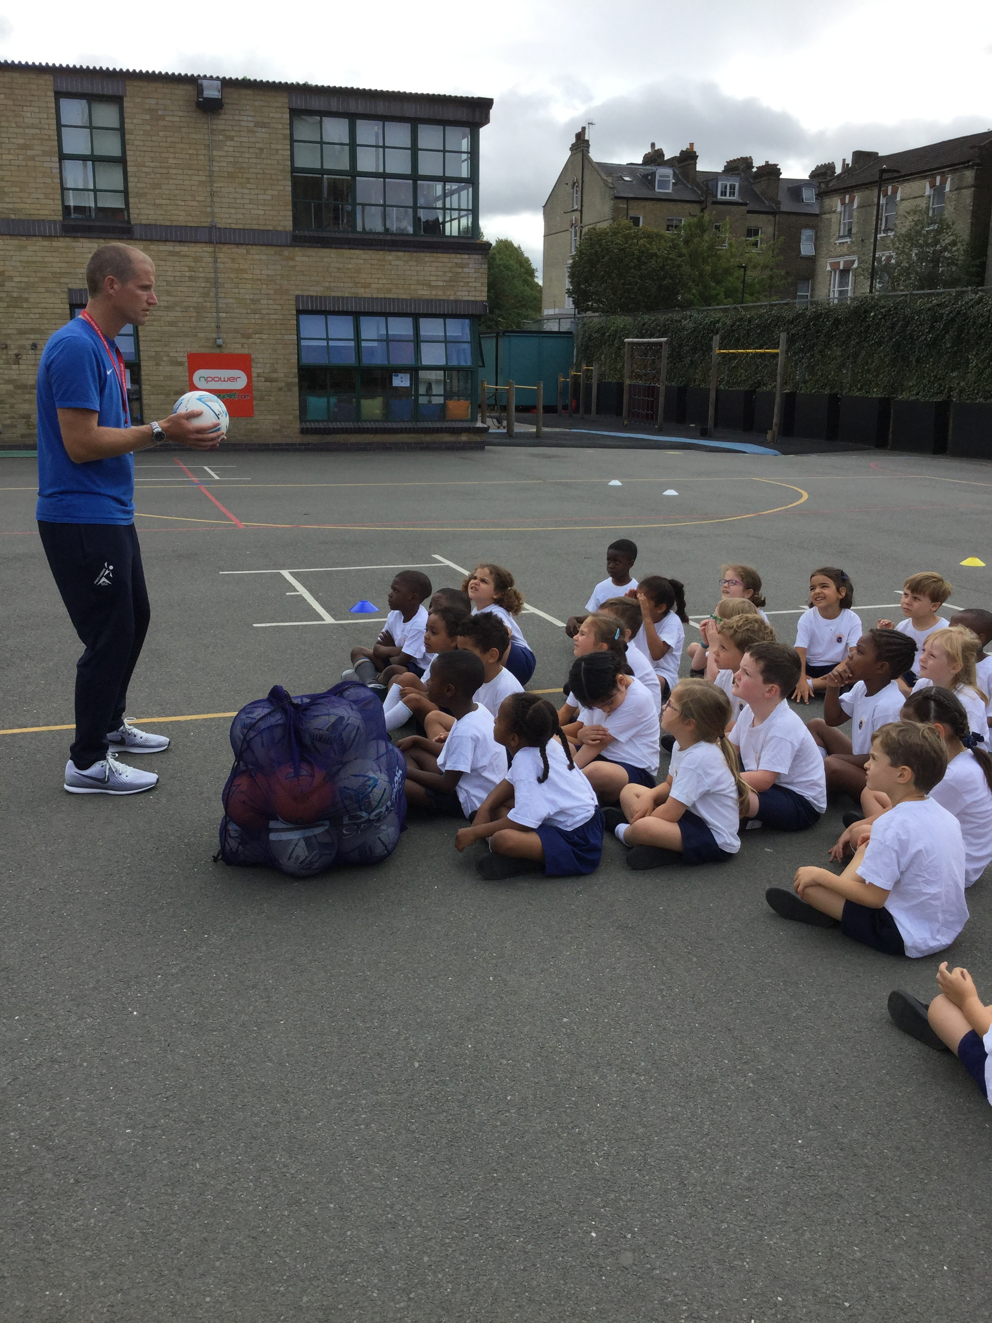
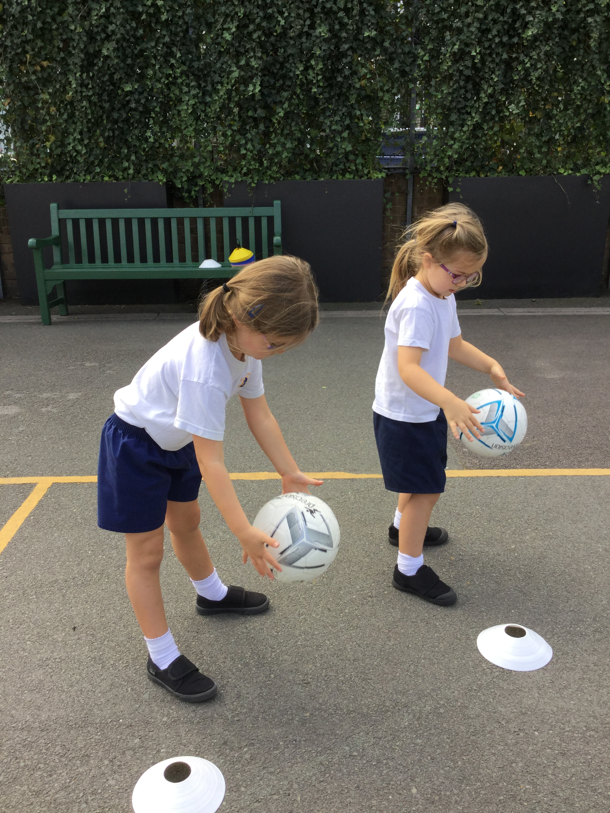
PE: Monday afternoon and Thursday morning
Children must bring their kits into school on a Monday and take it home on a Friday.
Please ensure that the P.E kit is returned the following day if your child takes it home after an after-school club e.g. Gym Club or Ballet.
Children may bring in trainers for outdoor lessons but they must also bring a pair of black plimsolls.
Children must bring in full P.E kit: white CC T-shirt, navy shorts and plimsolls.
Children may also bring in, alongside their PE kit, the CC navy tracksuit (Please do not send in a tracksuit as an alternative.)
If your child does not bring in their P.E kit, we will aim to phone to give you the option to bring it into school. Please note, we do not provide spare P.E. kits.

Slide 9
Show and Tell
Each child will be given the opportunity to present a 'Show and Tell' to their peers as they did in Reception.
This is a lovely opportunity for your child to talk about a topic of interest to them or to share a favourite toy or hobby.
Dates will be sent out so you will know when your child has their Show and Tell.
If you choose to create a Power Point presentation, please email it to the class teacher as we cannot use USB sticks on our school system.

Slide 10
Homework
Homework in Year 1 begins after October half term.
Homework is set on Thursdays with the aim to be completed by the following Tuesday.
It may be an online homework (Mathletics, Spellodrome or TimeTables Rockstars) or a worksheet(s).
The homework we set will be based on what the children have learnt at school that week. There will be one maths and one English activity.
We will sometimes inform parents about homework by email if required.
Weekly spellings.
One school reading book a week.

Slide 11
How to help at home: English
Reading in Year 1 is taught through English and phonics lessons as well as through group reading sessions.
Read a wide variety of texts to your child. This may include fiction and non-fiction books, magazines, recipes, comics, shopping lists, internet pages etc. Remember to let your child see you enjoying reading too.
Try to give your child opportunities to write for a purpose. This could be in the form of a diary, scrap book, post-cards or letters/emails to friends.

Slide 12
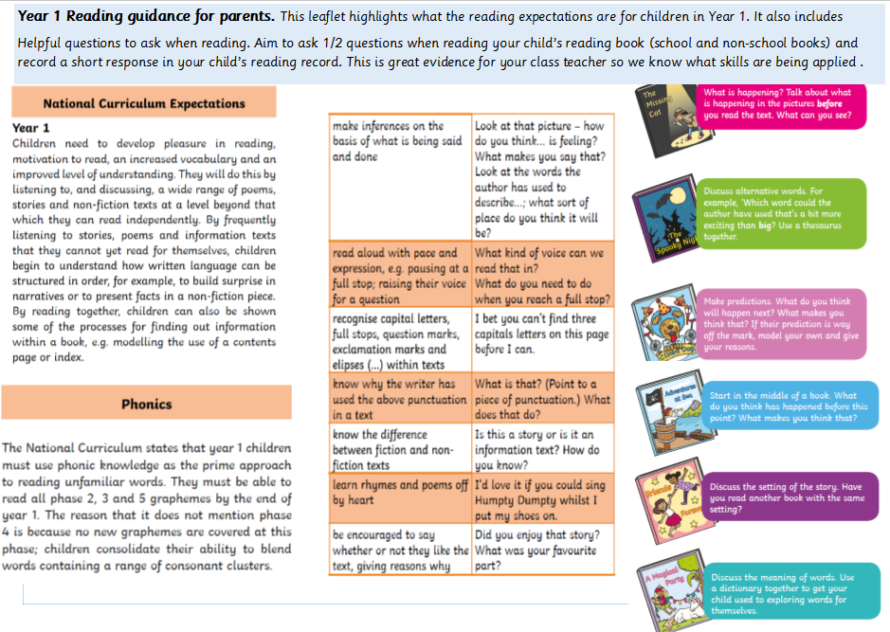
Reading

Slide 13
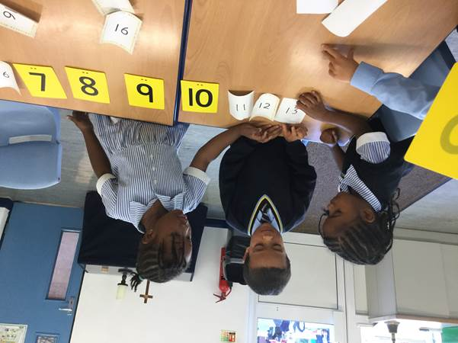
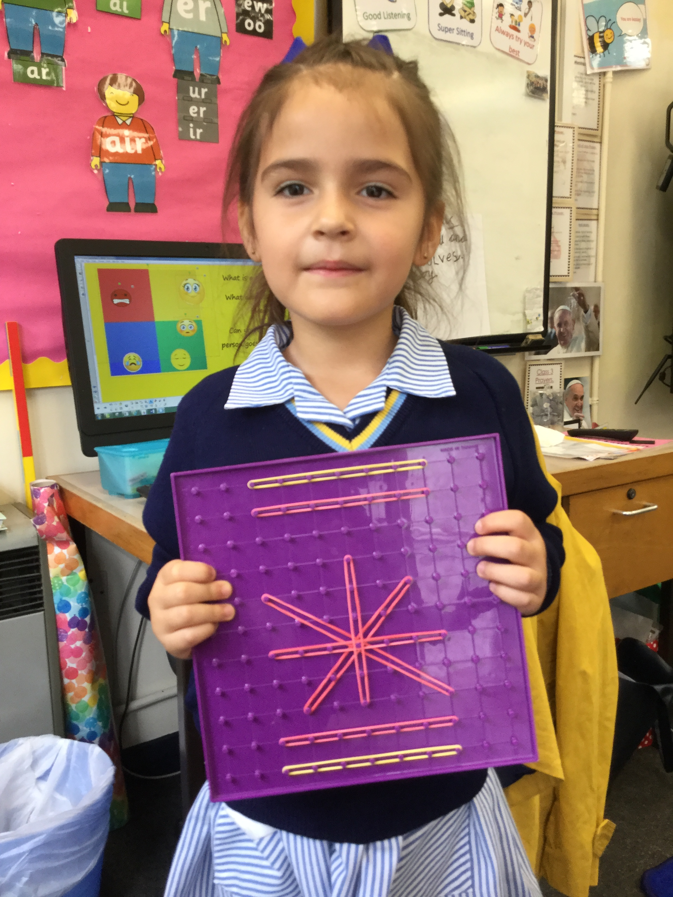
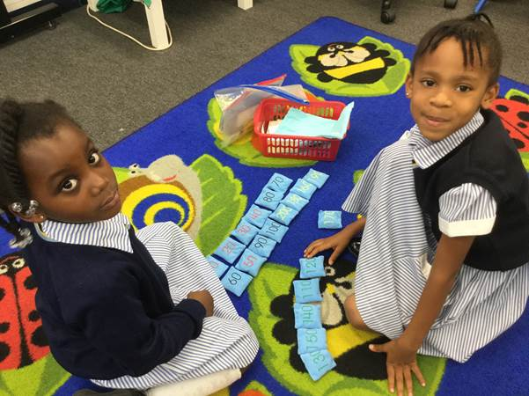
How to help at home: Maths
Use a 100 square to practise counting forwards and backwards in steps of tens and ones from any 2 digit number. (www.numbersplat.co.uk)
Use the terms 10 more, 10 less, 1 more , 1 less with 2 digit numbers.
Place value: Identifying tens and ones. (Partitioning.)
Practice counting on and back in steps of 2, 5 and 10.
Play shop! Children can make their own price tags for their toys then practice the concept of finding change using simple amounts e.g. Apples cost 5p and I need to buy 2 apples. How much will it cost?
Practice doubling, halving and using the four operations (adding, subtracting, multiplying and dividing).

Slide 14
School trips/visitors and dates
If you wish to volunteer on a school trip please speak to/email your class teacher.
Monday 23rd September: Theatre workshop – Where in the UK is Baxter Bear? School based.
Tuesday 15th October, Wednesday 16th October: Parents Evening
Break-up for half term Thursday 17th October
Friday 8th November (am): Key Stage 1 trip to Streatham Odeon to see The Grinch.
Thursday 12th December (pm) and Friday 13th December (am): KS1 Nativity.
Tuesday 17th December: Unicorn Theatre Trip to see the Wolf, the Duck and the Mouse.

